Slide 1
Microprocessors
Lecture 20

Slide 2
Protection
In PVAM, the 80286 has built-in features for the following protection schemes:
Protecting. system software such as the operating system from user programs.
Protecting one user task from another.
Protecting portions of memory from accidental access.
The 80286 protection mechanism is implemented by using the contents of the descriptors.
Any access to memory is validated by checking the information in segment descriptors. The 80286 generates an interrupt if the memory access is invalid.

Slide 3
The 80286 provides protection mechanism for supporting multitasking and virtual memory features.
The 80286 includes certain basic protection features such as segment limit and segment usage checking.
These basic protections are useful even though multitasking and virtual ₋memory may not be available in a system.

Slide 4
In order to protect the operating system, the 80286 does not allow accessing a higher privilege entry point without its access gate.
The 80286 provides some instructions controlled by its IOPL (Input/Output Privilege Level) feature to protect shared system resources. The I/O instructions are permitted at the highest privilege level.
The 80286 on-chip protection features handle basic violations such as trying to access code segment instead of stack segment by trapping into the operating system’s appropriate routine.

Slide 5
Thus, the operating system recovers a faulty task by taking whatever actions are necessary.
The 80286 protection hardware provides information such as stack status to inform the operating system of the fault type.
The 80286 on-chip protection hardware provides up to four privilege levels in a hierarchical manner which can be used to protect system software such as the operating system from unauthorized access.
The 80286 can read specific⁻ bits in its segment descriptor to obtain privilege levels of each code and data segment.
Figure 4.6 shows the format for a segment descriptor for a code or data segment.

Slide 6
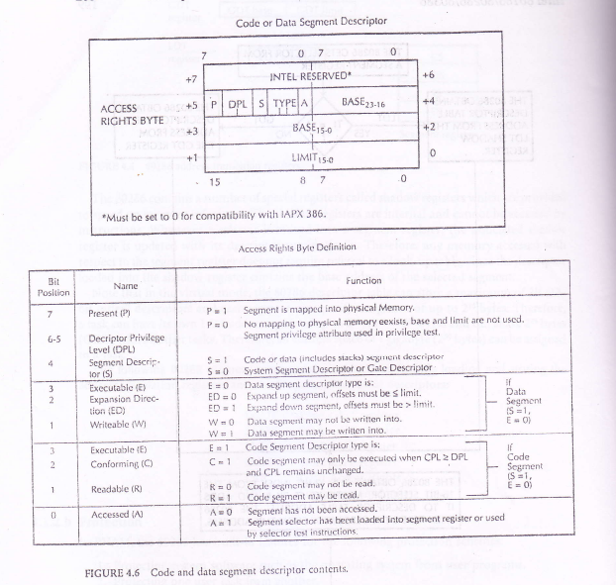

Slide 7
The descriptors include four words. Bit 3 of the 3-bit-type field of the access rights byte is called the Executable (E) bit. E= 1 identifies a code segment descriptor, while E= 0 identifies the segment as a data segment descriptor.
The two-bit DPL (Descriptor Privilege Level) provides the privilege level of the descriptor. The DPL field specifies a hierarchical privilege system of four levels 0 thru 3.
Level -0 is the highest level while level 3 is the lowest. Privilege level provides protection within a task.
Operating system routines, interrupt handlers, and other system software can be included and protected within the virtual address space of each task using the four levels of privileges. Each task in the system has a separate stack for each of its privilege levels. Typical examples of. privilege levels are summarized as follows:

Slide 8
A single privilege level can be assigned to all the code of a dedicated 80286.
In this case, all load/store and I/O instructions are available. The 80286 can be initialized by setting the PE bit in MSW to one and then loading the GDTR with appropriate values to address a valid global descriptor table.
Privilege levels can be assigned to user and supervisor mode types of applications. In this case, all system software can be defined as level 0 (highest level) and all other programs at some lower privilege level.
For large applications, the system software can be divided into critical and noncritical.

Slide 9
All critical software can be defined as a kernel with the highest privilege level (level 0), the noncritical portion of the system software is defined with levels 1 and 2, while all user application programs are defined with the lowest level (level 3).
Upon enabling the protected mode bit, the 80286 basic protection features -are available irrespective of a single 80286-type application or user/supervisor configuration or a large application.
The descriptor’s limit and the access rights byte provide the 80286’s basic protection features.
Segment limit checking ensures that all memory accesses are physically available in the segment.

Slide 10
For all read and write operations with memory, the 80286 in the protected mode automatically checks the offset of an effective address with the descriptor limit (predefined).
This limit checking feature ensures that a software fault in a segment does not interfere with any other segments in the system.
The access right byte along with limit checking ensures proper usage of the segments. At least three types of segments can be defined using the access byte.
The hierarchical protection levels have four logical rules. These are summarized below:
The Current Privilege Level (CPL) at any instant of time represents the level of the code segment presently being executed. This is provided by the privilege level in the access rights byte of the descriptor. The 80286 gives the value of CPL in its code register.
.

Slide 11
Since every privilege level has its own stack, a stack segment rule is implemented in the 80286 to ensure using the proper stack.
According to this rule, the stack segment (stack addressed by the stack segment register) and the current code segment must have the identical privilege level.
As far as the data segments are concerned, the DPL (Descriptor Privilege Level) of an accessed data segment must be lower than or equal to the CPL. This rule allows protection of privileged data segments from unpriviliged codes.

Slide 12
The 80286 controls the use of I/O instructions. The user may choose the level at which these I/O instructions can be used. This level is called the IOPL (Input Output Privilege Level).
IOPL is a two-bit flag whose value varies from 0 to 3. In a user/ supervisor configuration in which all supervisor code is at level 0(highest) and all user code is at lower levels, the IOPL should be 0.
This zero value of IOPL allows the supervisor code to carry out I/0 operations but ensures that the user code cannot execute these I/0 instructions.

Slide 13
Protection of a task from unauthorized access by another is provided by the 80286 both in virtual and physical memory spaces. The80286 provides a multitasking feature via its virtual memory capabilities.
As mentioned before, the virtual memory space consists of two spaces: global and local. The local space is unique to the present task being executed. This uniqueness of the local spaces provides intertask protection in the virtual memory space.
The 80286's limit checking feature in the physical memory space avoids illegal accesses of segments beyond the defined segment limits and thus provides protection.
Tile 80286 is especially designed to execute several different tasks simultaneously (appears to be simultaneous). This is called multitasking.
.

Slide 14
If the present task needs to wait for some external data, the 80286 can be programmed to switch to another task until such data are available.
This mechanism of switching from one task to another is called task switching.
The 80286 automatically performs all the necessary steps in order to properly switch from one task to another.
When a task switching takes place, the 80286 stores the state of the present task (typically most of the 80286 registers), loads the state of the new task, and starts executing the new task.
If execution of the outgoing task is desired after completion of the incoming one, the 80286 can automatically go back to the right place where the task switch took place.

Slide 15
Task switching may occur due to hardware or software reasons.
For example, task switching may take place due to 80286 external interrupt requests (hardware reason) or due to the operating system's desire to time-share the 80286 among multiple user tasks (software reason).
The task to be executed due to interrupts is termed interrupt-scheduled, while the task to be executed due to time-sharing by the operating system is called software-scheduled.

Slide 16
The 80286 provides protection for portions of memory -from accidental access in the following ways.
When a segment selector is to be loaded into a segment register, the 80286 automatically verifies whether the descriptor table indexed by the selector contains a valid descriptor for that selector.
An interrupt, is automatically generated by the 80286 if a valid descriptor is not present. However, if the descriptor is valid, the shadow registers are loaded with the base, limit, and access rights byte of the descriptor.
The 80286 then verifies whether the segment for ⁻that descriptor is resident in physical memory. An interrupt is generated by the 80286 if it is not present (as indicated by the P-bit of the access rights byte of the descriptor).

Slide 17
An interrupt service routine can be written to move the desired segment into physical memory and return execution to the main program.
The 80286 also verifies whether the segment descriptor is of the right type to be loaded into the appropriate segment register.
For example, an attempt to write to a read-only data segment will generate an error. Also, the limit value in the segment descriptor is used to ensure that an address generated by program instructions is within the limit specified for the segment.

Slide 18
80386 Addressing Modes
The 80386 has 11 addressing modes which are classified into register/immediate and memory addressing modes. Register/immediate type includes two addressing modes, while the memory addressing type contains the other nine modes.
1. Register/Immediate Modes - Instructions using these register or immediate modes operate on either register or immediate operands. i) Register Mode - The operand is contained in one of the 8, 16, or 32-bit general registers.
An example is DEC ECX which decrements the 32-bit register ECX by one. ii) Immediate Mode-The operand is included as part of the instruction.

Slide 19
An example is MOV EDX, 5167812FH which moves the 32-bit data 5167812F₁₆ to EDX register.
Memory Addressing Modes - The other 9 addressing modes specify the effective memory address of an operand. These modes are used when accessing memory.
An, 80386 address consists of two parts: a segment base address and an effective address. The effective address is computed by adding any combination of the following four components:
Displacement:- 8 or 32-bit immediate data following the instruction; 16-bit displacements can be used by inserting an address prefix before the instruction.

Slide 20
Base: The contents of any general-purpose register can be -used as base. Compilers normally use these base registers to point to the beginning of the local variable area.
Index: The contents of any general-purpose register except ESP can be used as an index register. The elements of an array or a string of characters can be accessed via the index register.
Scale: The index register's contents can be multiplied (scaled) by a factor of 1, 2, 4, or 8. Scaled index mode is efficient for accessing arrays or structures.

Slide 21
As shown in Figure 4.11, the Effective Address (EA) of an operand is computed according
to the following formula:
EA = Base reg + (Index Reg * Scaling) + Displacement

Slide 22
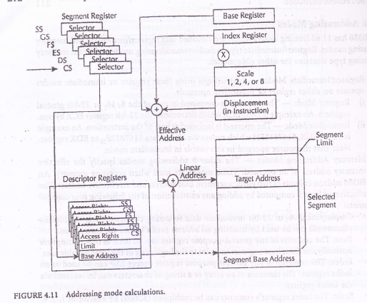

Slide 23
Direct Mode - The operand's effective address is included as part of the instruction as an 8-, 16-, or 32-bit displacement. An example is DEC WORDPTR [4000H].
Register Indirect Mode - A base or index register contains the operand's effective address. An example is MOV EBX, [ECX].
Based Mode - The contents of a base register are added to a displacement to obtain the operand's effective address. An example is MOV [EDX + 16], EBX.
Index Mode - The contents of an index register are added to a displacement to obtain the operand's effective address. An example is ADD START [EDI], EBX.
.

Slide 24
Scaled Index Mode - The contents of an index register are multiplied by a scaling factor (1, 2, 4, or 8) which is added to a displacement to obtain the operand's effective address. An example is MOV START (EBX * 8), ECX.
Based Index Mode -'The contents of a base register are added to the contents of an index register to obtain the operand's effective address. An example is MOV ECX, [ESI] [EAX].
Based Scaled Index Mode -The contents of an index register are multiplied by a scaling factor (1, 2, 4, or 8) and the result is added to the contents of a base register to determine the operand's effective address. An example is MOV [ECX * 4] [EDX], EAX.

Slide 25
Based Index Mode with Displacement - The operand's effective address is obtained by adding the contents of a base register and an index register with a displacement. An example is
MOV [EBX] [EBP + OF24782AH], ECX.
Based Scaled Index Mode with Displacement - The contents of an index register are multiplied by a scaling factor, and the result is added to the contents of a base register and a displacement to obtain the operand's effective address. An example is MOV [ESI*8][EBP + 60H], ECX.
The 80386 can execute 8086/80186/80286 16-bit instructions in real and protected modes.
This is provided in order to make the 80386 software compatible with the 80286, 80186, and the 8086.

